Slide 1
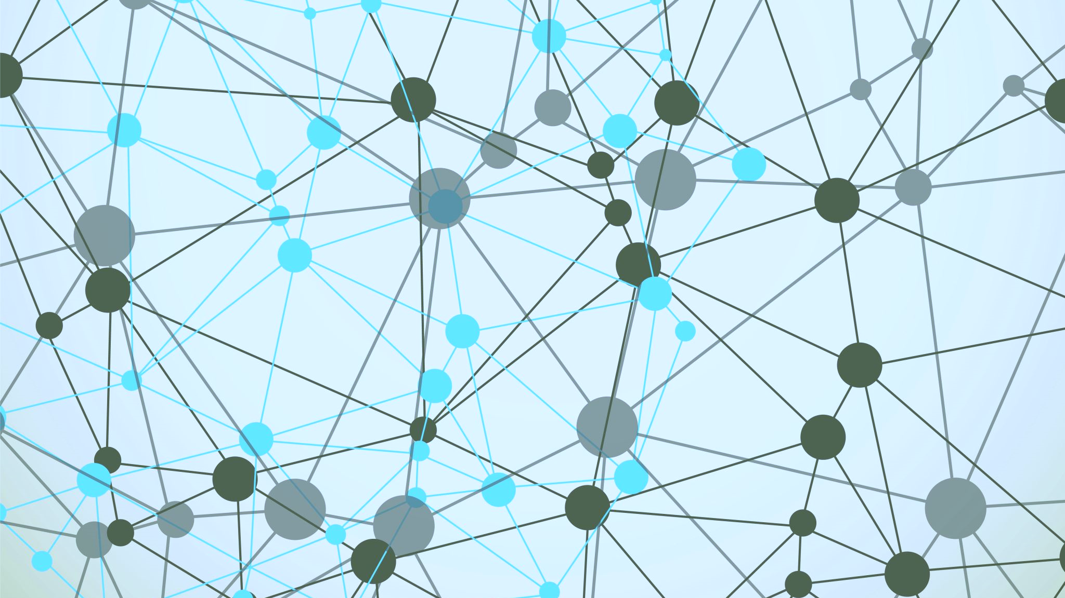
Exploring Social Justice through Metaliteracy and Algorithms
Catie Carlson, MLIS, MEd
1

Slide 2
Algorithms

Slide 3
What is an algorithm?
"An algorithm is a set of instructions or rules used by a computer to perform a specific task such as organizing search results by relevance"
(Gardner, 2019)
3

Slide 4
Injustice in Algorithms
Google search autosuggestions on January 25, 2013
Typed: Why are Black women so
Autocomplete suggestions: Angry, loud, mean, attractive, lazy, annoying, confident, sassy, insecure, bitter
Typed: Why are white women so
Autocomplete suggestions: pretty, beautiful, mean, easy, insecure, skinny, annoying, perfect, fake, rude
(Noble, 2018, p.21)
4

Slide 5
Within the Library, Too
Summon 2.0
Topic Explorer
Eurocentric skew
Wikipedia snapshot [outdated information]
Autosuggest
"While Ex Libris has blocked the Topic Explorer results for 'Muslim terrorist in the united states,' a search for 'Muslims are' in Summon will activate the autosuggest algorithm as seen in Figure 5.8, which offers only one suggestion: 'Muslims are terrorists.'"
(Redisma, 2019; Redisma, 2019, p. 127)
5

Slide 6
Prevalence
40% people believe "it is possible for computer programs to make decisions that are free from human bias. Notably, younger Americans are more supportive of the notion that computer programs can be developed that are free from bias.“
(Smith, 2018)

Slide 7
Impact
Biased Results
Unwavering algorithmic trust
Societal injustice
7

Slide 8
Questioning the Algorithm
"When you believe that a decision generated by a computer is better or fairer than a decision by a human, you stop questioning the validity of the inputs to the system. It's easy to forget the principle of garbage in, garbage out- especially if you really want the computer to be correct. It's important to question whether these algorithms, and the people who make them, are making the world better or worse."
(Broussard, 2018, p. 44)
8

Slide 9
Within the Framework
"In addition, this Framework draws significantly upon the concept of metaliteracy, which offers a renewed vision of information literacy as an overarching set of abilities in which students are consumers and creators of information who can participate successfully in collaborative spaces."
(ACRL, 2016)
9

Slide 10
Metaliteracy Goals
Evaluate content critically, including dynamic, online content that changes and evolves, such as article preprints, blogs, and wikis.
1
Understand personal privacy, information ethics, and intellectual property issues in changing technology environments.
2
Share information and collaborate in a variety of a participatory environments.
3
Demonstrate ability to connect learning and research strategies with lifelong learning processes and personal, academic, and professional goals.
4
(Mackey & Jacobson, 2014, p. 86).
10

Slide 11
There is a need to incorporate algorithmic understanding in education to create disruption.
Algorithms in Metaliteracy
11

Slide 12
Evaluate content critically, including dynamic, online content that changes and evolves.
Personalization
Rankings
Capitalism
12

Slide 13
Evaluate: Personalization
Factors
Location
Influences
Advertising
Online History
Voice Queues
Search Results
c
(Feldman, 2015; Gardner, 2019; Head et al., 2020; Miller, 2016; Noble, 2013)
13

Slide 14
Evaluate: Rankings
What happens when a search for "Black girls" = Porn?
What are the implications when your interests (i.e. search history) are not stereotypical?
Popularity = Good/Authoritative Assumption
Bot manipulation to be first result
(Broussard, 2018; Cleverley, 2017; Koenig, 2020; Noble, 2018; Orabi et al., 2020)
14

Slide 15
Evaluate: Capitalism
Advertising Revenue
Clickbait
Erosion of journalism & editors
(Faix, 2018)
15

Slide 16
Understand personal privacy, information ethics, and intellectual property issues in changing tech environments.
Privacy
Classification
Black Box
16

Slide 17
Understand: Black Box
Proprietary knowledge
Technically complex
Calls for transparency
(Kulshrestha et al., 2019; Shin & Park, 2019)
17

Slide 18
Understand: Privacy
Big data
Poor people = free data
Marginalized further marginalized
(Broussard, 2018; Miller, 2016; Pena & Nicklas, 2019)
18

Slide 19
Understand: Classification
Sociocultural context of classification systems
Abolished or controversial LCSH
Neutrality not possible
(Bains, 2020; Noble, 2018)
19

Slide 20
Share informationand collaborate in a variety of a participatory environments.
Editorialization
Social Media
User Behavior
20

Slide 21
Share: User Behavior
Likes, Shares, & Engagements for future content
Information dissemination
Care in academic research vs personal research
(Alsasd et al., 2018; Head et al, 2020; Vraga, 2019)
21

Slide 22
Share: Editorialization
Influence on story tips, curation, and content
"Social media sites functioned like a news editor" (p. 19) for the consumer and the journalist
(Head et al, 2020)
22

Slide 23
Share: Social Media
Sharing and finding of mis- and dis-information
(Faix, 2018)
23

Slide 24
Demonstrate ability to connect learning and research strategies with lifelong learning processes and goals.
Education & Curriculum
Peer to Peer Learning
24

Slide 25
Connect: Education & Curriculum
Conversations and curriculum centered in power and social justice
Reflection on the flow of information
Intentional incorporation of digital and information literacy
(Cook et al, 2016; Fister, 2021; Head et al., 2020; Jacobson et al., 2019)
25

Slide 26
Connect: P2P Learning
Swapping notes on how to by-pass algorithmic assumptions
Students feel more knowledgeable than instructors
(Head et al., 2020)
26

Slide 27
Discussion Questions
How does your institution approach information literacy learning? Can algorithmic education be taught in guest lectures?
27

Slide 28
References
Alsaad, A., Taamneh, A., & Al-Jedaiah, M. N. (2018). Does social media increase racist behavior? An examination of confirmation bias theory. Technology in Society, 55, 41–46. https://doi.org/10.1016/j.techsoc.2018.06.002
Association of College & Research Libraries [ACRL]. (2016). Framework for information literacy for higher education. https://www.ala.org/acrl/standards/ilframework
Bains, J. (2020). Search engines and algorithms are biased: Here’s why that matters. Information Outlook, 24(1), 21–23.
Broussard, M. (2018). Artificial unintelligence: How computers misunderstand the world. MIT Press.
Cleverley, P. (2017). Search algorithms: Neutral or biased? Online Searcher, 41(5), 12–17.
Cooke, N.A., Sweeney, M.E. & Noble, S.U. (2016). Social justice as a topic and tool: An attempt to transform an LIS curriculum and culture. The Library Quarterly, 86(1), 107-124. https://doi.org/10.1086/684147
Faix, A. (2018). Teaching online research in the “Fake News” Era. Association Supporting Computer Users in Education.
Feldman, E. M. (2015). The influence of social media on adult learners’ knowledge construction and democratic participation. New Horizons in Adult Education & Human Resource Development, 27(4), 59–65.
Fister, B. (2021, February 3). Lizard people in the library [blog post]. Project Information Literacy. https://projectinfolit.org/pubs/provocation-series/essays/lizard-people-in-the-library.html
Gardner, C.C. (2019). Teaching algorithmic bias in a credit-bearing course. International Information & Library Review, 51(4), 321-327. https://doi.org/10.1080/10572317.2019.1669937
Head, A.J., Fister, B., & MacMillan, M. (2020). Information literacy in the age of algorithms: Student experiences with news and information, and the need for change. Project Information Literacy.
Jacobson, T., Head, A., & Lippincott, J. (2019). 7 things you should know about Digital Literacies. EDUCAUSE Learning Initiative (ELI). https://library.educause.edu/resources/2019/7/7-things-you-should-know-about-digital-literacies
Koenig, A. (2020). The algorithms know me and I know them: Using student journals to uncover algorithmic literacy awareness. Computers and composition, 58. https://doi.org/10.1016/j.compcom.2020.102611
Kulshrestha, J., Eslami, M., Messias, J., Zafar, M. B., Ghosh, S., Gummadi, K. P., & Karahalios, K. (2019). Search bias quantification: investigating political bias in social media and web search. Information Retrieval Journal, 22(1/2), 188–227. https://doi.org/10.1007/s10791-018-9341-2
Mackey, T.P. & Jacobson, T.E. (2014). Metaliteracy: Reinventing information literacy to empower learners. Neal-Schuman.
Miller, A. C. (2016). Confronting confirmation bias: Giving truth a fighting chance in the information age. Social Education, 80(5), 276–279.
Noble, S.U. (2013). Google search: Hyper-visibility as means of rendering black women and girls invisible. Invisible culture, 19.
Noble, S.U. (2018). Algorithms of oppression: How search engines reinforce racism. New York University Press.
Orabi, M., Mouheb, D., Al Aghbari, Z., & Kamel, I. (2020). Detection of bots in social media: A systematic review. Information Processing & Management, 57(4).
Peña Gangadharan, S., & Niklas, J. (2019). Decentering technology in discourse on discrimination. Information, Communication & Society, 22(7), 882–899. https://doi.org/10.1080/1369118X.2019.1593484
Reidsma, M. (2019). Masked by trust: Bias in library discovery. Litwin Books.
Shin, D., & Park, Y. J. (2019). Role of fairness, accountability, and transparency in algorithmic affordance. Computers in Human Behavior, 98, 277–284. https://doi.org/10.1016/j.chb.2019.04.019
Smith, A. (2018) Public attitudes toward computer algorithms. Pew Research Center. https://www.pewresearch.org/
Vraga, E. K. (2019). What can I do? How to use social media to improve democratic society. Political Communication, 36(2), 315–323. https://doi.org/10.1080/10584609.2019.1610620
28

Slide 29
Catie Carlson Associate Librarian University of Cincinnati catie.carlson@uc.edu
THANK YOU!
29

